Slide 1
Operational Transformation

Slide 2
What is Operational Transformation?
is an optimistic consistency control method in collaborative editing system or groupware.
Extended capabilities of Operational Transformation:
Consistency maintenance.
Concurrency Control.
Group undo.
Locking.
Conflict resolution.
Operation notification and compression, group-awareness.
HTML/XML and tree-structured document editing.

Slide 3

Consistency maintenance in OT
OT is able to maintain shared document consistency while allowing multi-users to generate operations freely and concurrently and the system to respond to local users quickly and execute remote operations in different orders.
Consistency Models:
CC model.
CCI model.
CSM model.
CA model.

Slide 4
Consistency Properties
Causality preservation: ensures the execution order of causally dependent operations be the same as their natural cause-effect order during the process of collaboration.
Convergence: ensures the replicated copies of the shared document be identical at all sites.
Intention preservation: ensures that the effect of executing an operation on any document state be the same as the intention of the operation.

Slide 5
Continued…
Single-operation effects: the effect of executing any operation in any execution state achieves the same effect as in its generation state.
Multi-operation effects: the effects relation of any two operations is maintained after they are both executed in any states.
Admissibility: The invocation of every operation is admissible in its execution state, i.e., every invocation must not violate any effects relation (object ordering) that has been established by earlier invocations.

Slide 6
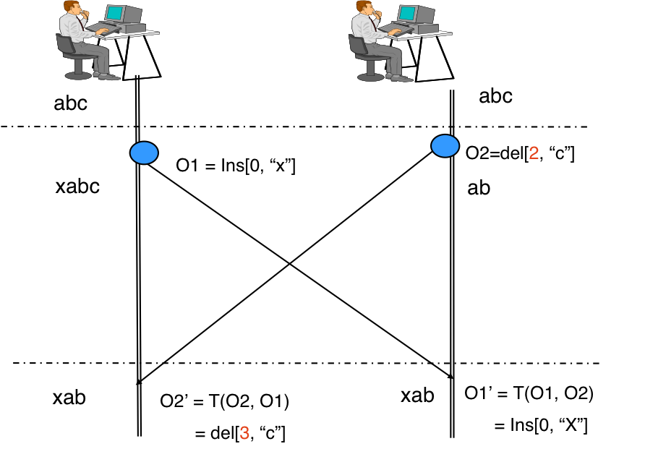
How consistency and concurrency are maintained in OT?
Two Current Operations:
O1 = Insert[0, "x"] (to insert character "x" at position "0").
O2 = Delete[2, "c"] (to delete the character "c" at position "2").
In order to maintain the consistency OT transforms the parameters of an editing operation according to the effects of previously executed concurrent operations.

Slide 7
Operational transformation: Data Model
The data model of an OT system defines the way data objects in a document are related to each other and referenced by operations.
Single linear address space: Each object has a positional reference in this address space.
Example:
plain text documents,
presentation documents.
Hierarchy of multiple linear address space
Example:
Word processor,
HTML/XML document,
Digital media document.

Slide 8
Operational transformation: Operation Model
The set of operations directly processed by transformation functions.
Two primitive operations:
Insertion.
Deletion.
Additional primitive operations:
Update.

Slide 9
Operational Transformation system structure
Operational Transformation control Algorithm (determines which operations are transformed against others according to their concurrency/context relations)
Operational Transformation Properties and Conditions (divide responsibilities between algorithms and functions)
OT Transformation Functions (determines how to transform a pair of primitive operation according to their operation type, position and other parameter)

Slide 10


Transformation control algorithm
Transformation control algorithms are responsible for determining when an operation (transformation target) is ready for transformation, which operations (transformation reference) should be transformed against, and in which order should transformations be carried out.
Transformation control algorithms are generic in the sense they rely on generic relations among operations to do the work. Control algorithms provide input operations to transformation functions.
Control Algorithm
Output
Transform Function

Slide 11
Transformation Functions
Transformation functions are responsible for performing actual transformations on the target operation according to the impact of the reference operation.
Transformation functions are dependent on the types and parameters of operations, and data and operation model of the OT system.
Transformation functions produce output operations for control algorithms.

Slide 12
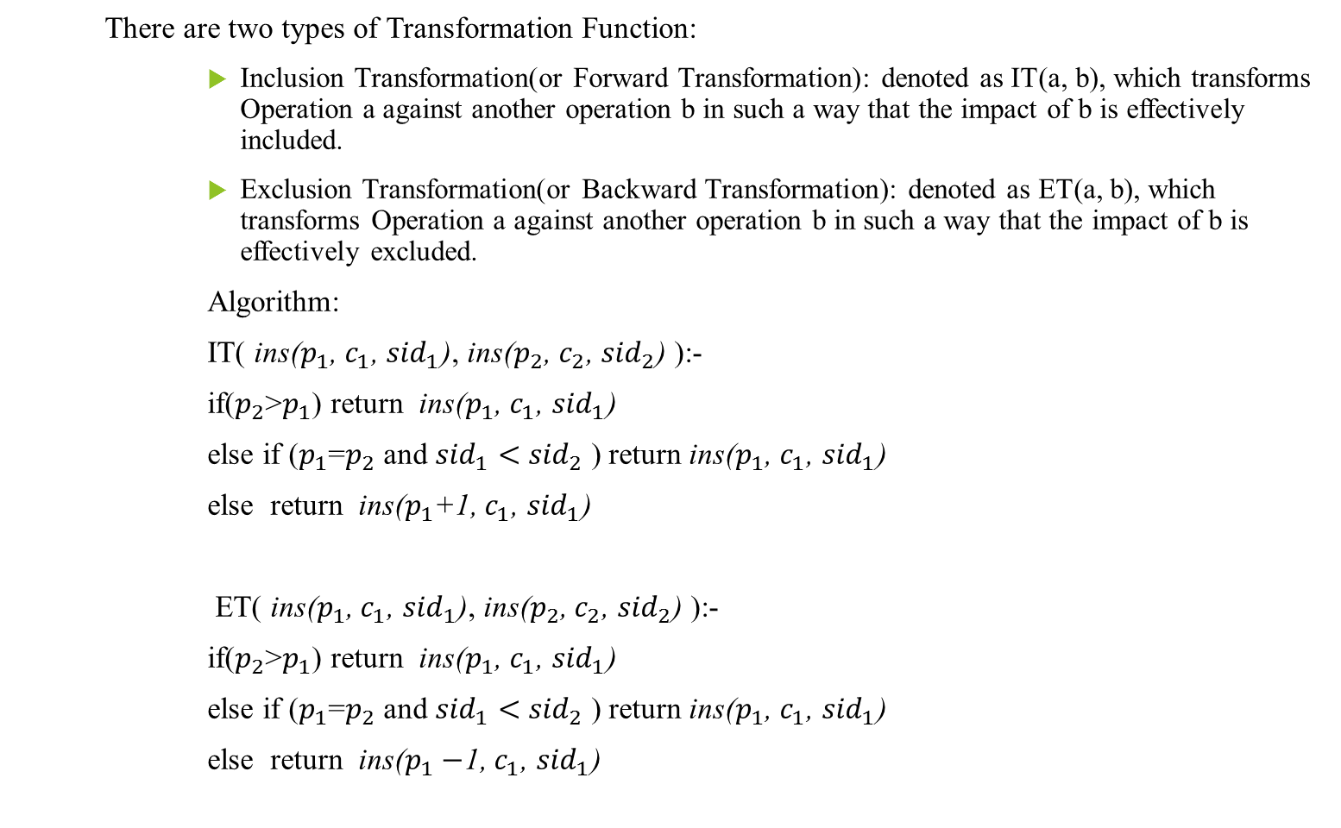
Continued…
There are two types of Transformation Function:
Inclusion Transformation(or Forward Transformation): denoted as IT(a, b), which transforms Operation a against another operation b in such a way that the impact of b is effectively included.
Exclusion Transformation(or Backward Transformation): denoted as ET(a, b), which transforms Operation a against another operation b in such a way that the impact of b is effectively excluded.
Algorithm:
IT( ins($p_{1}$, $c_{1}$, ${sid}_{1}$), ins($p_{2}$, $c_{2}$, ${sid}_{2}$) ):-
if($p_{2}$>$p_{1}$) return ins($p_{1}$, $c_{1}$, ${sid}_{1}$)
else if ($p_{1}$=$p_{2}$ and ${sid}_{1}<{ sid}_{2}$ ) return ins($p_{1}$, $c_{1}$, ${sid}_{1}$)
else return ins($p_{1}$+1, $c_{1}$, ${sid}_{1}$)
ET( ins($p_{1}$, $c_{1}$, ${sid}_{1}$), ins($p_{2}$, $c_{2}$, ${sid}_{2}$) ):-
if($p_{2}$>$p_{1}$) return ins($p_{1}$, $c_{1}$, ${sid}_{1}$)
else if ($p_{1}$=$p_{2}$ and ${sid}_{1}<{ sid}_{2}$ ) return ins($p_{1}$, $c_{1}$, ${sid}_{1}$)
else return ins($p_{1}−$1, $c_{1}$, ${sid}_{1}$)

Slide 13

Design of character-wise transformation functions
$Case 1: T_{1}$(ins($p_{1}$, $c_{1}$), ins($p_{2}$, $c_{2}$)){
if($p_{1}<p_{2}$ or ${(p}_{1}$= $p_{2}$ and $u_{1}$>$u_{2}$))
return ins($p_{1}$, $c_{1}$);
else return ins($p_{1}$+1, $c_{1}$);}
Case 2: $T_{2}$(ins($p_{1}$, $c_{1}$), del($p_{2}$)){
if($p_{1}≤p_{2})$
return ins($p_{1}$, $c_{1}$);
else return ins($p_{1}−$1, $c_{1}$);}

Slide 14
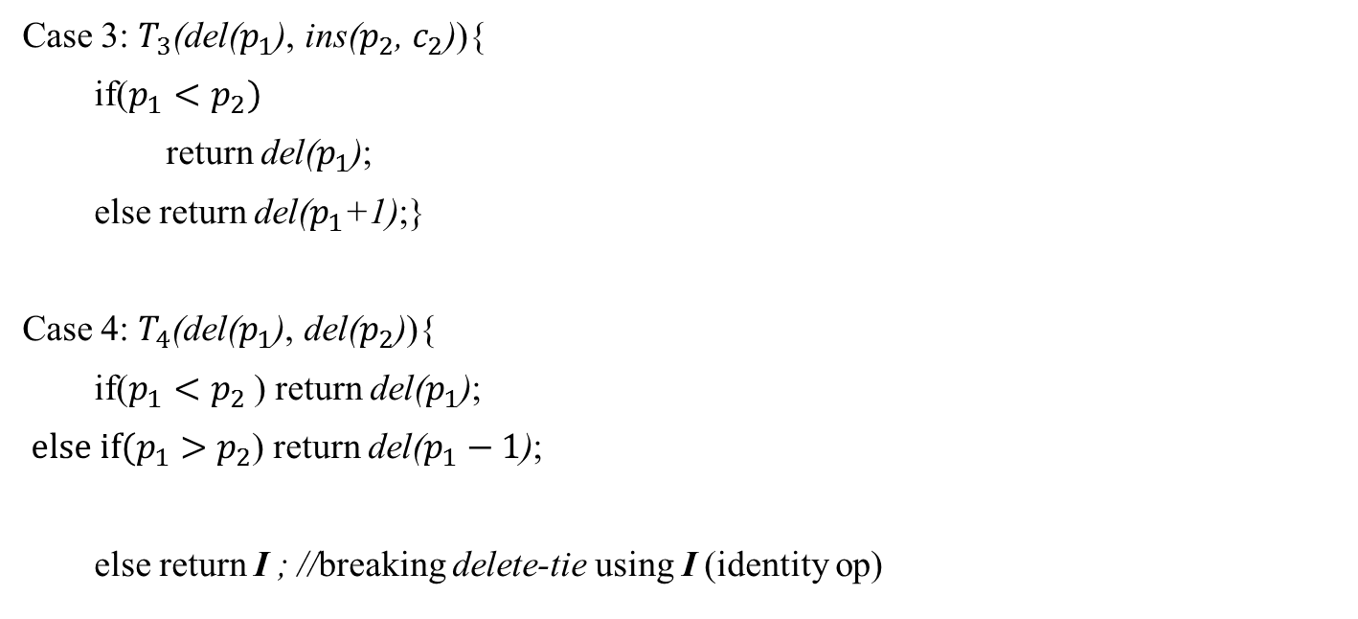
Continued…
Case 3: $T_{3}$(del($p_{1}$), ins($p_{2}$, $c_{2}$)){
if($p_{1}<p_{2})$
return del($p_{1}$);
else return del($p_{1}$+1);}
Case 4: $T_{4}$(del($p_{1}$), del($p_{2}$)){
if($p_{1}<p_{2}$ ) return del($p_{1}$);
${else if(p}_{1}>p_{2}$) return del($p_{1}−1$);
else return I ; //breaking delete-tie using I (identity op)

Slide 15
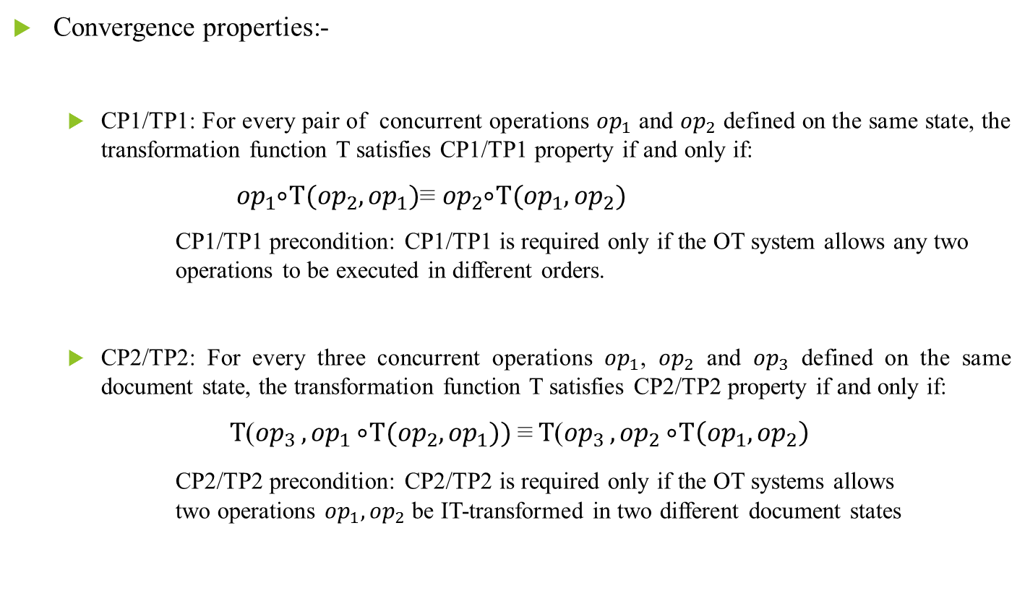
Transformation properties
Convergence properties:-
CP1/TP1: For every pair of concurrent operations ${op}_{1}$ and ${op}_{2}$ defined on the same state, the transformation function T satisfies CP1/TP1 property if and only if:
${op}_{1} ⃘⃘⃘T({op}_{2},{op}_{1})$≡ ${op}_{2} ⃘⃘⃘T({op}_{1},{op}_{2})$
CP1/TP1 precondition: CP1/TP1 is required only if the OT system allows any two operations to be executed in different orders.
CP2/TP2: For every three concurrent operations ${op}_{1}$, ${op}_{2}$ and ${op}_{3}$ defined on the same document state, the transformation function T satisfies CP2/TP2 property if and only if:
$T$(${op}_{3 },{op}_{1} ⃘⃘⃘T({op}_{2},{op}_{1}))$≡$T$(${op}_{3 },{op}_{2} ⃘⃘⃘T\left({op}_{1},{op}_{2}\right)$
CP2/TP2 precondition: CP2/TP2 is required only if the OT systems allows two operations ${op}_{1},{op}_{2}$ be IT-transformed in two different document states

Slide 16
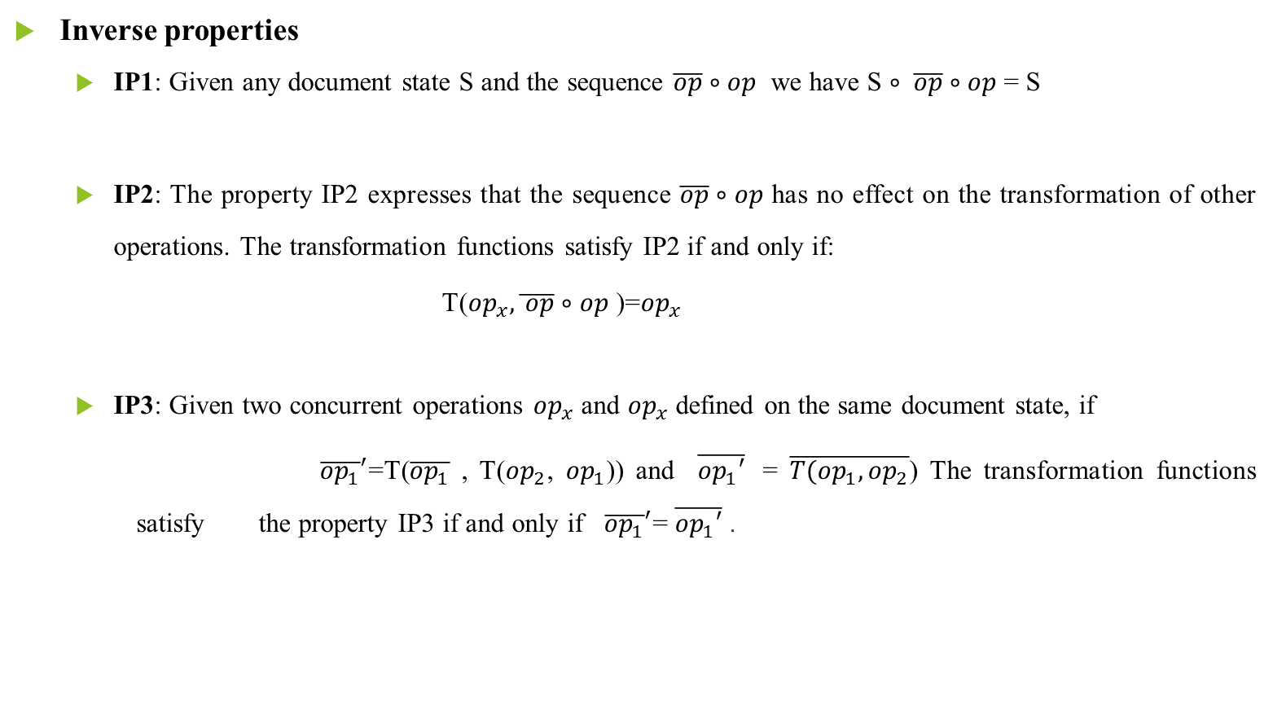
Continued…
Inverse properties
IP1: Given any document state S and the sequence $\overline{op}∘op$ we have S $∘ \overline{op}∘op$ = S
IP2: The property IP2 expresses that the sequence $\overline{op}∘op$ has no effect on the transformation of other operations. The transformation functions satisfy IP2 if and only if:
T(${op}_{x},\overline{ op}∘op$ )=${op}_{x}$
IP3: Given two concurrent operations ${op}_{x}$ and ${op}_{x}$ defined on the same document state, if
${\overline{{op}_{1}}}^{′}$=T($\overline{{op}_{1}}$ , T(${op}_{2}$, ${op}_{1}$)) and $\overline{{op}_{1}′}$ = $\overline{{T(op}_{1},{op}_{2}}$) The transformation functions satisfy the property IP3 if and only if ${\overline{{op}_{1}}}^{′}$= $\overline{{op}_{1}′}$ .

Slide 17
Collaborative editing system
What is Collaborative editing system?
Collaborative editing is a process of writing and editing documents or projects by more than one person.
Collaborative editing can be performed in real-time or in non-real-time.
Challenges in Real time collaborative editing tools
Consistency maintenance in the face of concurrent accesses to shared objects is one of the core issues in the design of these types of systems.
Concurrency control.
Consistency
Network latency

Slide 18
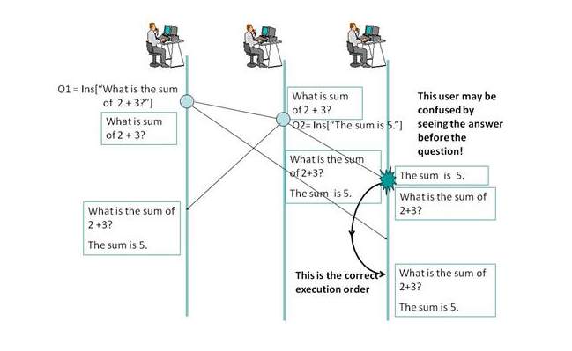
Need of OT in CE
At the first result (at site 3)of cause-effect relation is not maintained.
The causality violation problem can be solved using State Vector Timestamp.
State Vector Timestamp used to determine happened-before relation between two operations .

Slide 19
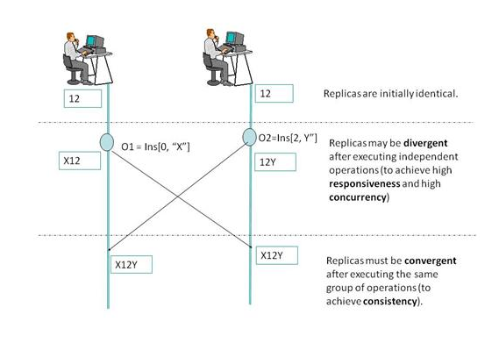
Continued…
Convergence requirement
Convergence requires the copies of the shared document be identical when the same group of operations has been performed, particularly at the end of a collaboration session.

Slide 20
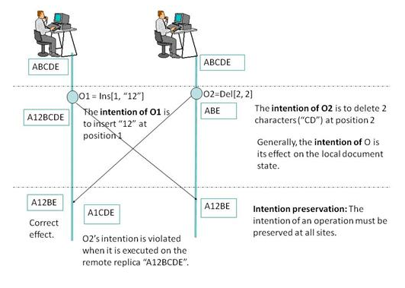
Continued…
Intention preservation requirement
the intention of an operation be preserved at all sites, regardless of interleaving execution of concurrent operations.
Intention preservation can be achieved using Inclusion Transformation function

Slide 21
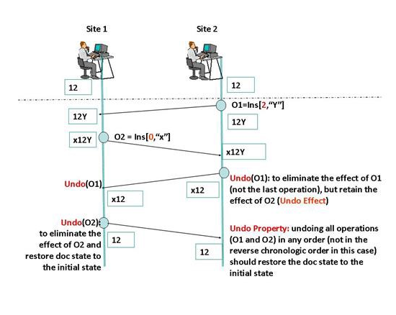
Undo Related Application
One is the undo effect, which requires that undoing an operation O achieves the effect of eliminating the effect of O but retains the effects of other operations in the document.

